Slide 1
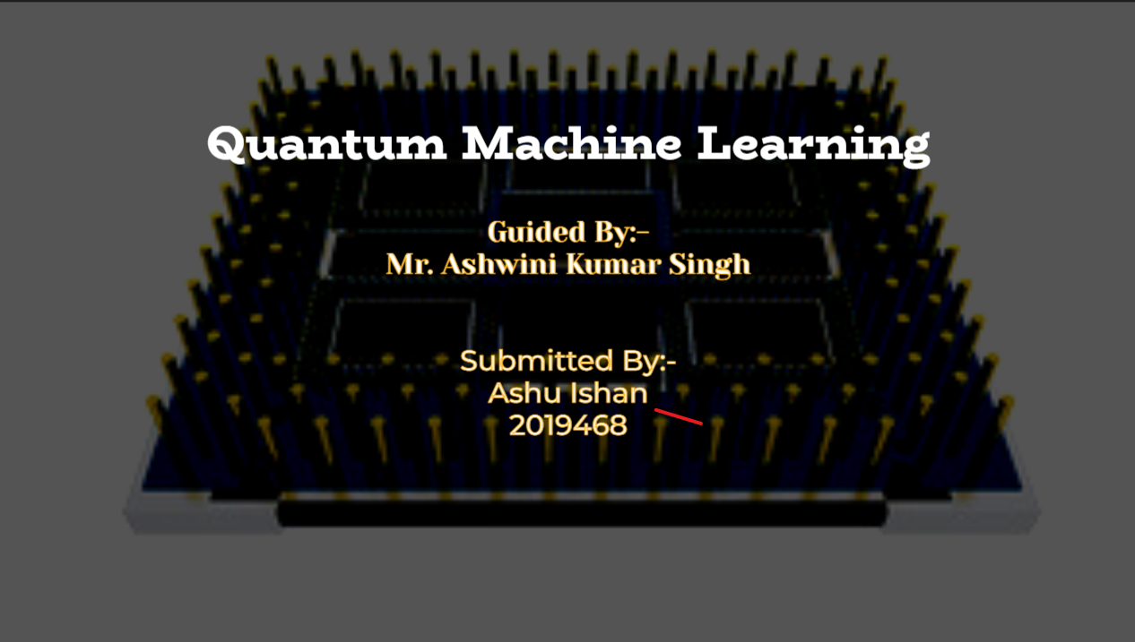

Slide 2
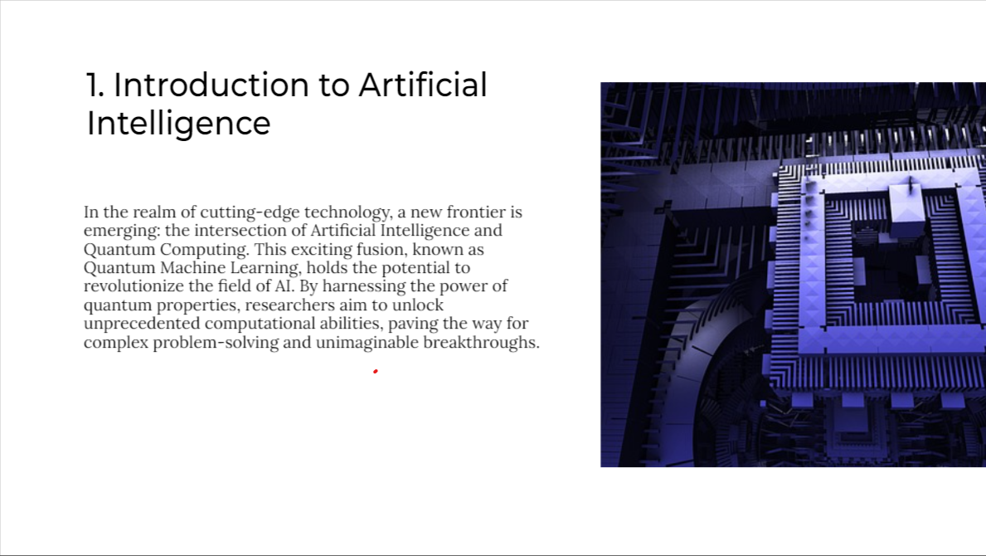

Slide 3
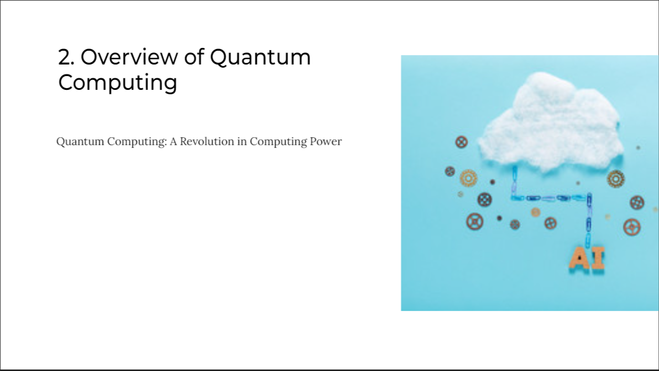
Quantum computing is a revolutionary paradigm in computing that leverages the principles of quantum mechanics to perform certain types of computations much more efficiently than classical computers. Unlike classical bits, which can be in a state of 0 or 1, quantum bits or qubits can exist in a superposition of both states simultaneously. This allows quantum computers to process a vast amount of information in parallel.
Key concepts in quantum computing include:
Superposition: Qubits can exist in multiple states at once, allowing quantum computers to perform many calculations simultaneously.
Entanglement: Qubits can become entangled, meaning the state of one qubit is directly related to the state of another, even if they are physically separated. This enables the creation of highly correlated quantum systems.
Quantum gates: These are the quantum analogs of classical logic gates. Quantum gates manipulate qubits by changing their states based on quantum principles.
Quantum parallelism: Quantum computers can process a large number of possibilities at the same time, providing potential speedups for specific types of problems.

Slide 4
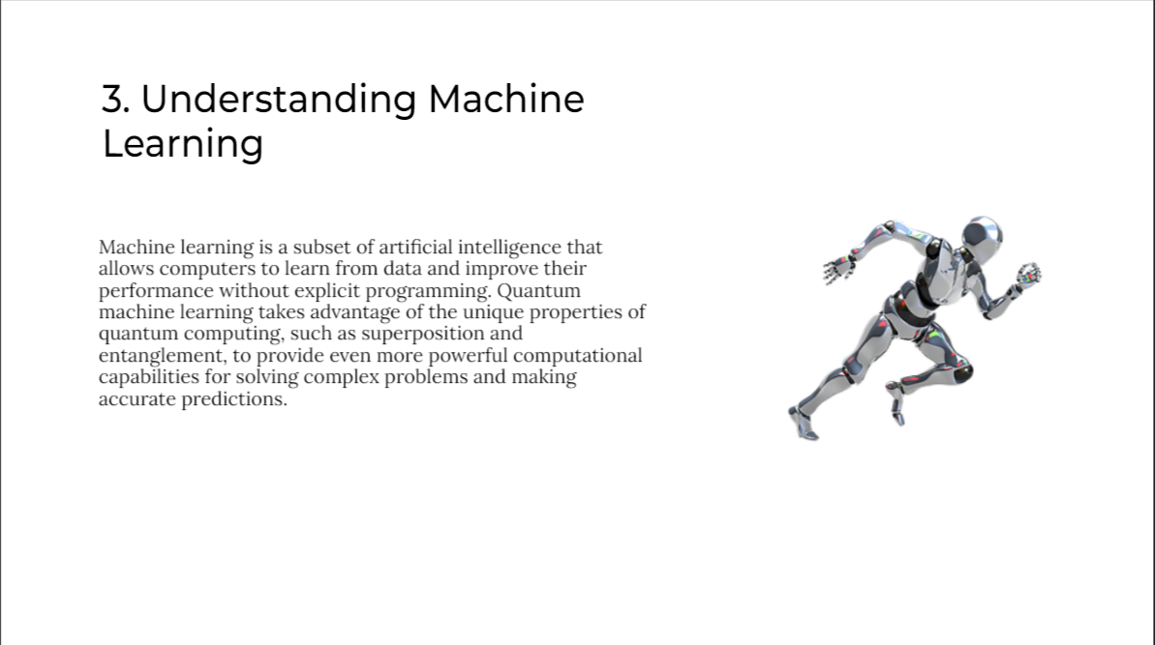

Slide 5
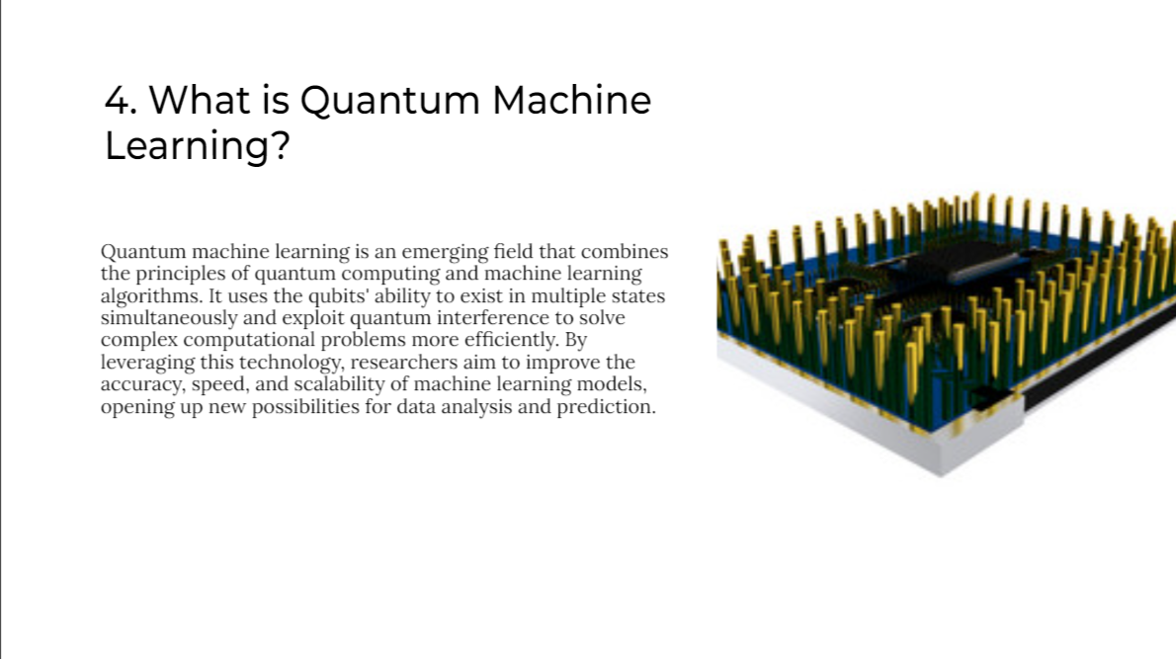

Slide 6

METHODOLOGY
Quantum Circuit Creation (create circuit):
The create circuit function generates a simple quantum circuit for parameter estimation.
It uses the Quantum Circuit class from Qiskit to create a quantum circuit with one qubit and one classical bit.
The circuit applies a rotation gate (ry) on the qubit by an angle of 2 * theta radians around the y-axis.
It then measures the qubit and stores the result in the classical bit.
Running the Quantum Circuit (run circuit):
The run circuit function simulates the execution of the quantum circuit on a Qiskit simulator backend.
It transpiles the quantum circuit to the target backend, assembles it into a Qiskit qobj, and then runs the simulation.
The results (counts of different measurement outcomes) are obtained using backend.run(circuits).result().
3.Visualizing the Estimation Results (visualize estimation):
The visualize estimation function takes the results of the quantum circuit execution and the chosen value of theta.
It prints the chosen theta value and the estimation results (measurement outcomes).
The function then uses plot-histogram from Qiskit's visualization module to display a histogram of the measurement outcomes.
4.Initialization Block:
It sets a value for theta (in this case, np.pi / 4), representing the parameter to be estimated.
It then runs the quantum circuit with the chosen theta value and visualizes the estimation results using the visualize sestimation function.

Slide 7
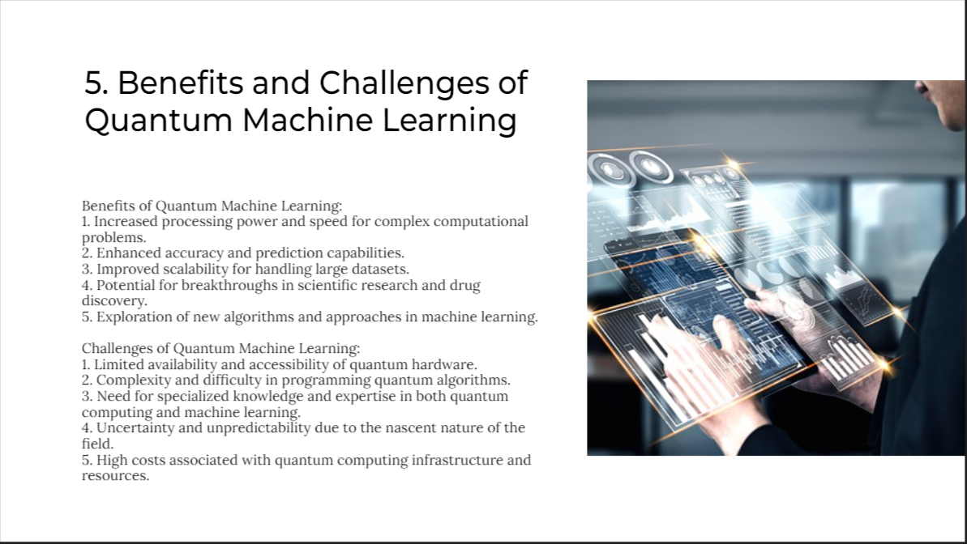

Slide 8
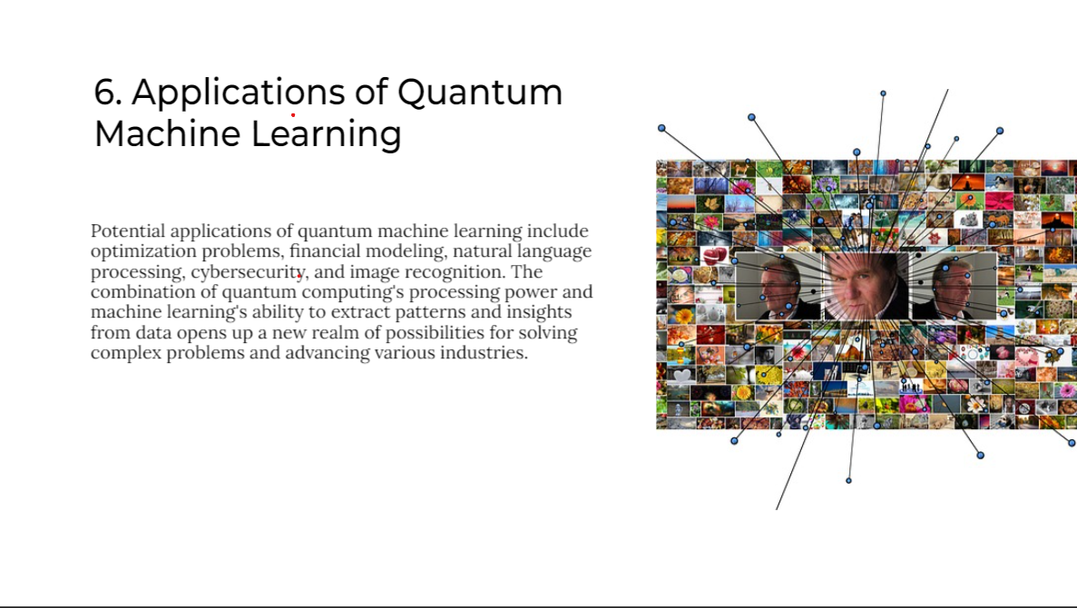

Slide 9
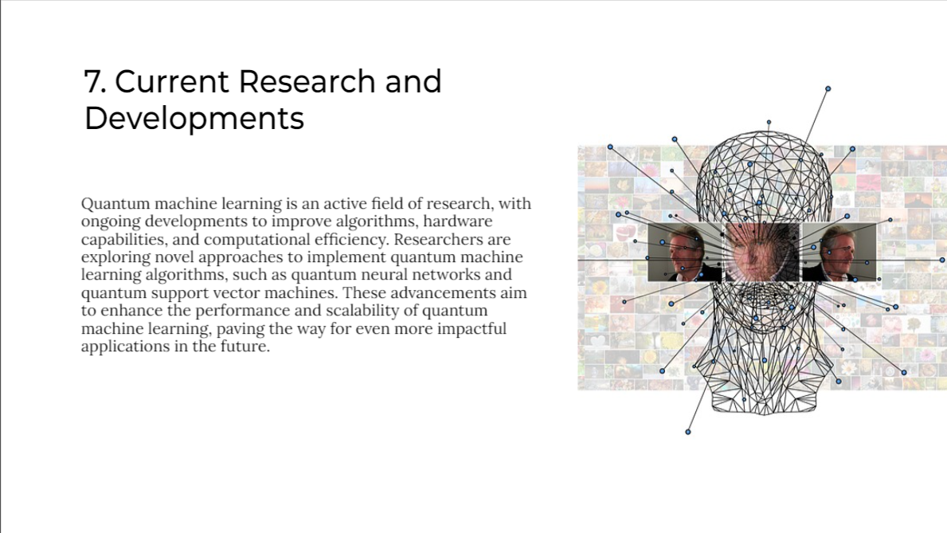

Slide 10
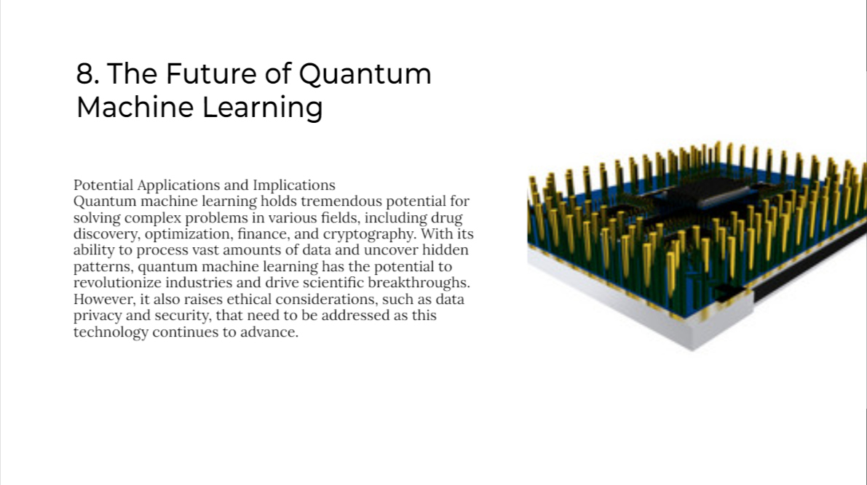

Slide 11
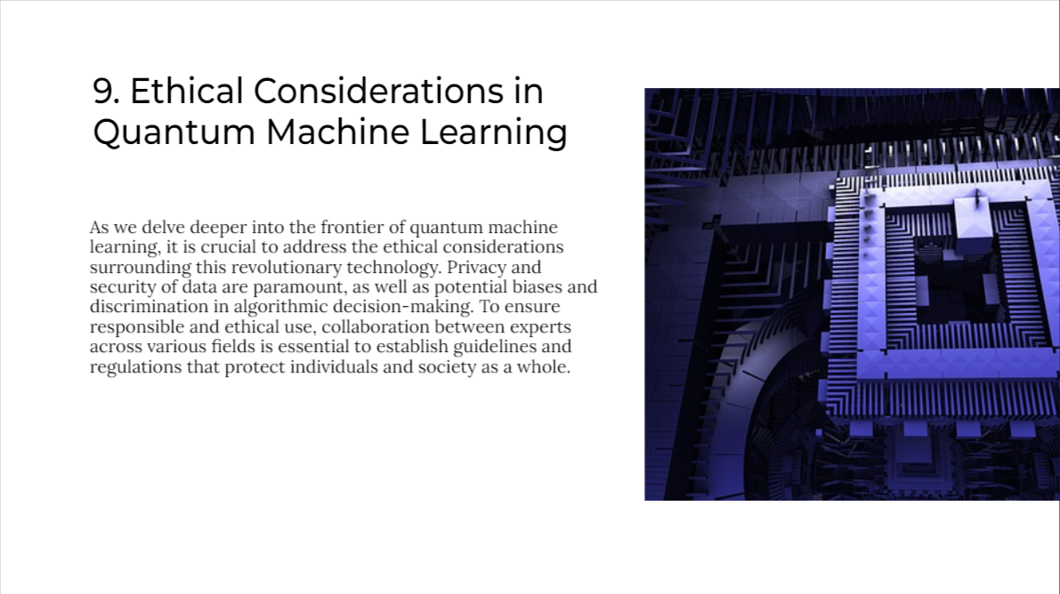

Slide 12
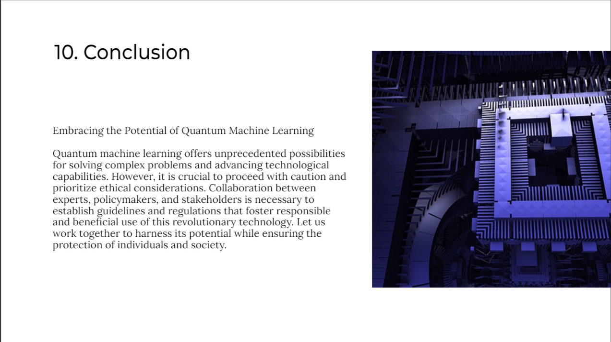

Slide 13

THANK YOU
ashu22082001@gmail.com

